Slide 1
Fire Department
10-year Plan and
2024-2025 Budget Proposal

Slide 2
2-year Immediate Needs
Security
Security Cameras
Door Access
Technology
Software – Accomplished
iPads on Frontline Apparatus
Personnel Changes
Revamp Job Descriptions – Accomplished
1 Additional Firefighter to fit current Scheduling deficiency
Pay Evaluations - based on comparable size city/ departments - Accomplished
TML Pay Study – 86th percentile
Regional Studies by National Fire Protection Association (NFPA) – 78th Percentile

Slide 3
2-year (continued) Immediate Needs
Updates to Annual Training Plan
Live In-house Training Requirements
Web based training
Forms of Revenue
Revenue Recovery Programs
Emergency Services District (ESD)
Grants
Purchase of Chief Vehicle

Slide 4
By end of Year 5
Personnel Changes
Hiring of additional Personnel (have a minimum of 6 paid FF)
Considerations
Potential Part-time personnel during transitions
Use of Potential ESD Funds to accomplish
Staffing for Adequate Fire and Emergency Response (SAFER) Grant
Switch to 24/48 hr shifts
Upgrades to Current Station
PPE Gear Room – NFPA Required by 2026
Addition of Living Quarters – For 24-hour shifts
Remodel to Kitchen/ Bathrooms
Implementation of an Apparatus Replacement Program

Slide 5
By end of Year 10
Additional Station
Industrial Location
Train Delays
Additional Manpower for Addition Station

Slide 6
10-Year plan Disclaimers
Changes should be justifiable and Financially Responsible
These goals will be continually re-evaluated to confirm that they fit the growth and changes in the City of Mineola.

Slide 7
Budget
10-year Plan was presented at this time to Help explain some of the following request.
Multiple lines items in the Fire Department budget are requested to stay the same as the current budget year, have a slight decrease, or will have minimal increases based on contractual obligations.
Concentrate on the line items with major changes or request.
Any question about line items not mentioned are welcomed.

Slide 8
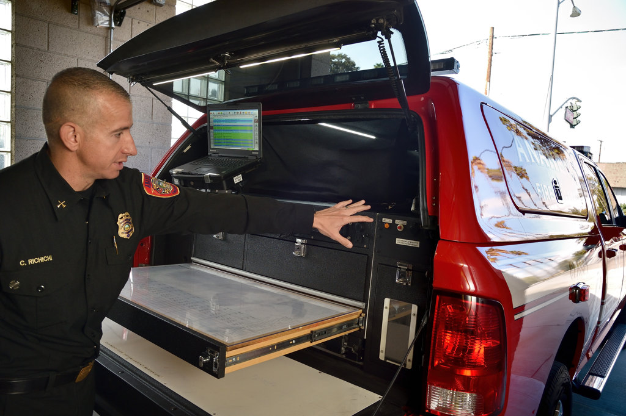
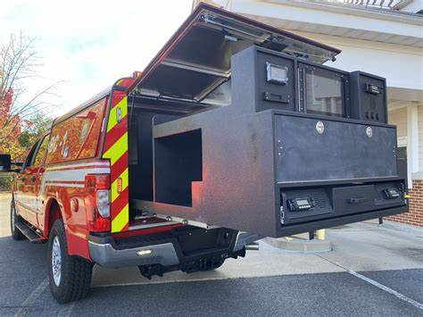
Budget Requested Chief’s Vehicle
Chief/ Command Vehicle
Quick After-Hours Response
Lights/ Radio Package
Incident Command Station
Accountability / Safety
Benchmark Tracking
Amount Requested - $82,000
Fully outfitted Ford F150 or Chevy Silverado

Slide 9
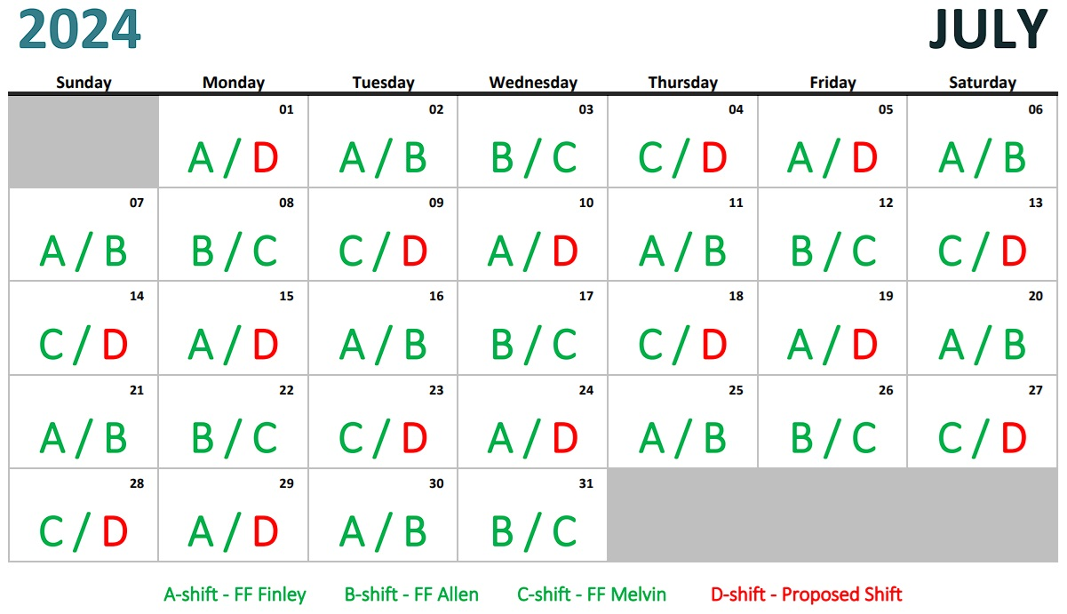
Budget Requested
Salaries/ Personnel Services
COLA Proposed by Mrs. Rushing
1 Additional personnel Requested to fill current Scheduling deficiency
Salary & Benefits Proposed
Salary - $46,438
Benefits - $25,801
Total Requested - $72,239

Slide 10
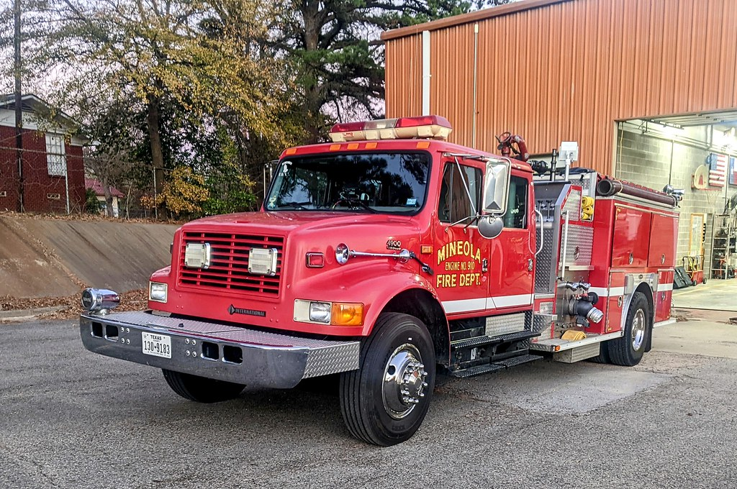
Budget Proposal Repair / Maintenance
Building Repair – Increase of $9000 over current year Budget
Cost of Materials for repairs Has Increased
Station Constructed in 1986
Plumbing Updates
Renovations to Restrooms & Kitchen
Auto/ Truck Repair – Increase is needed
Ageing Apparatus
More Preventative maintenance required
Frequency of Repairs needed
Repair Cost Increases

Slide 11
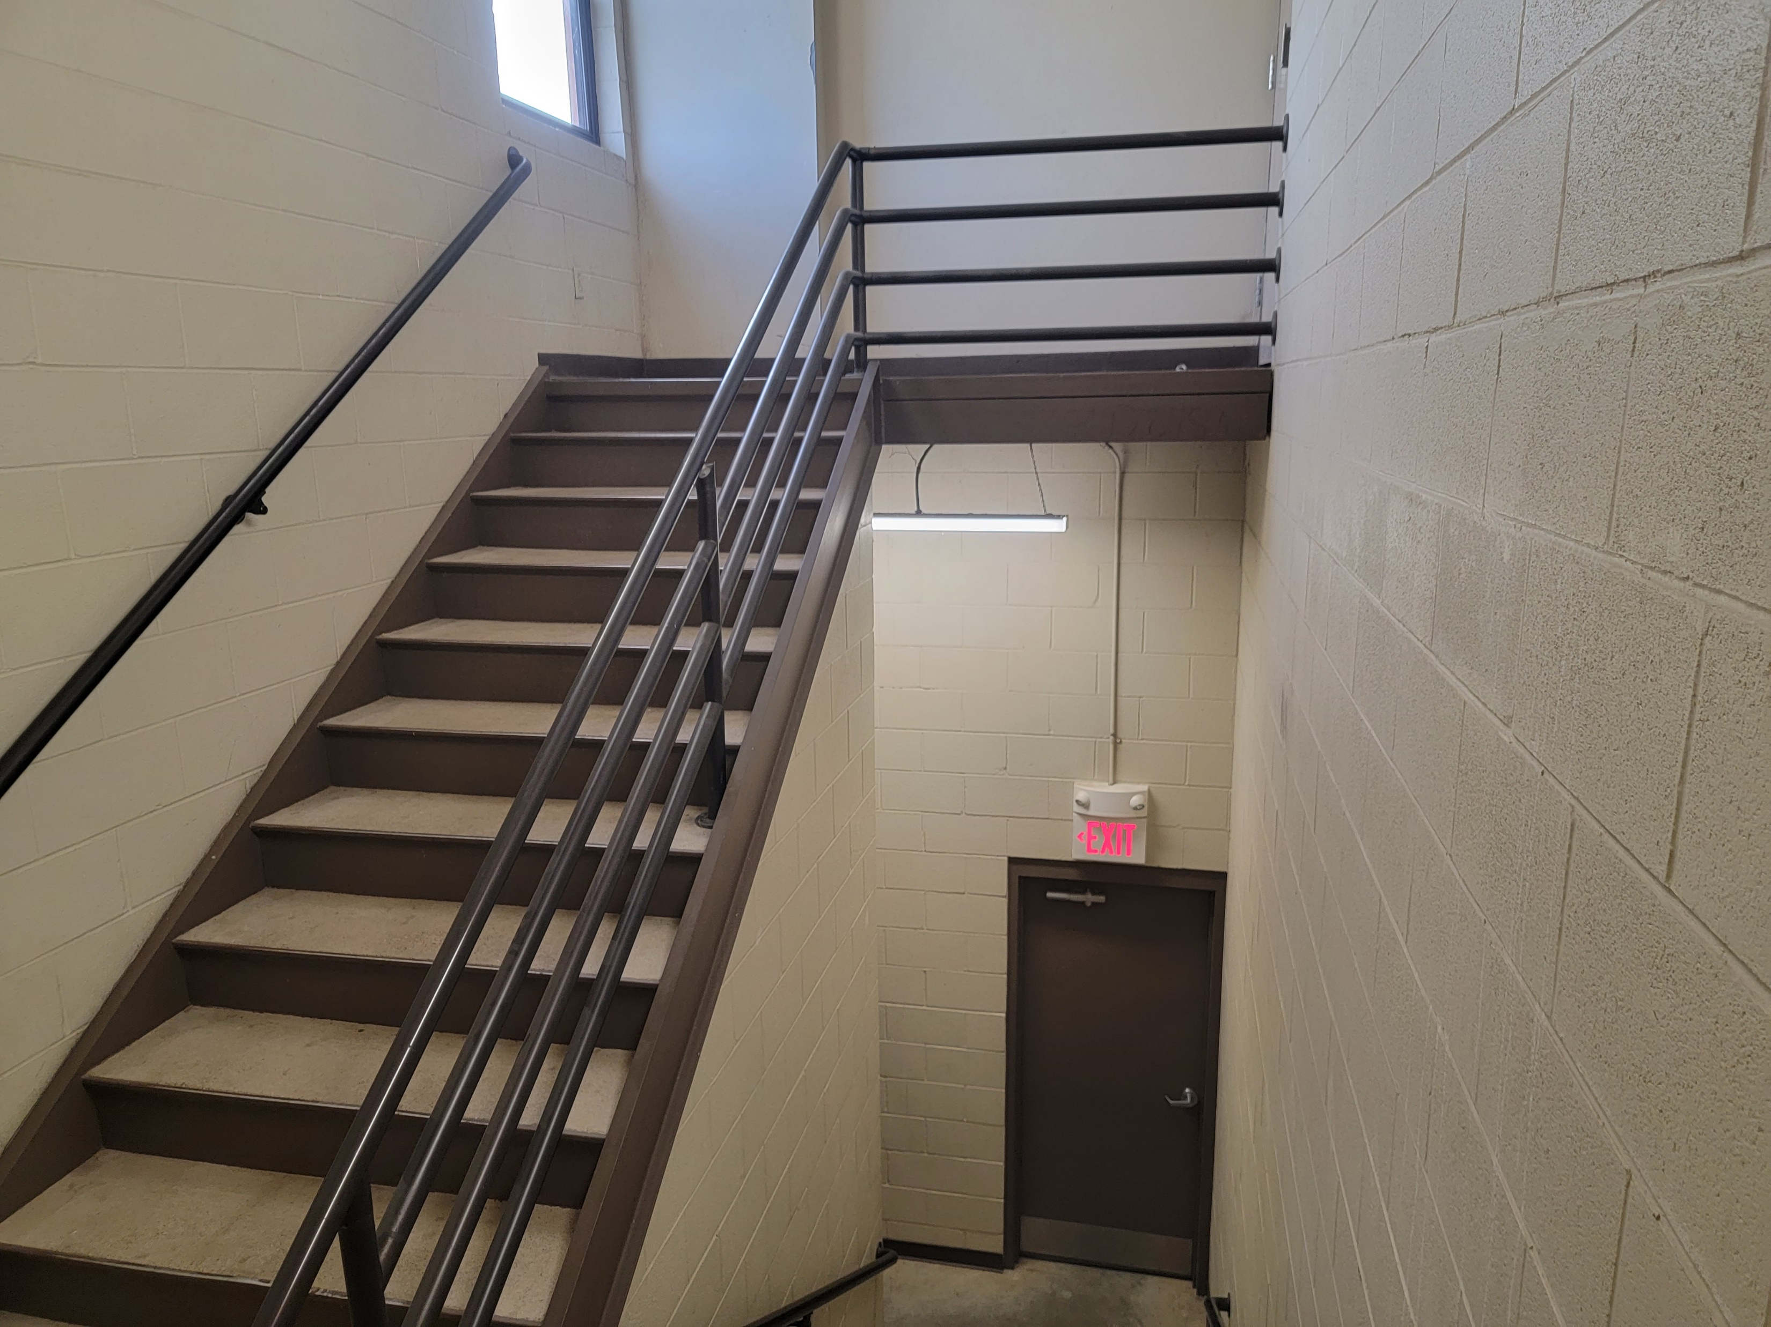
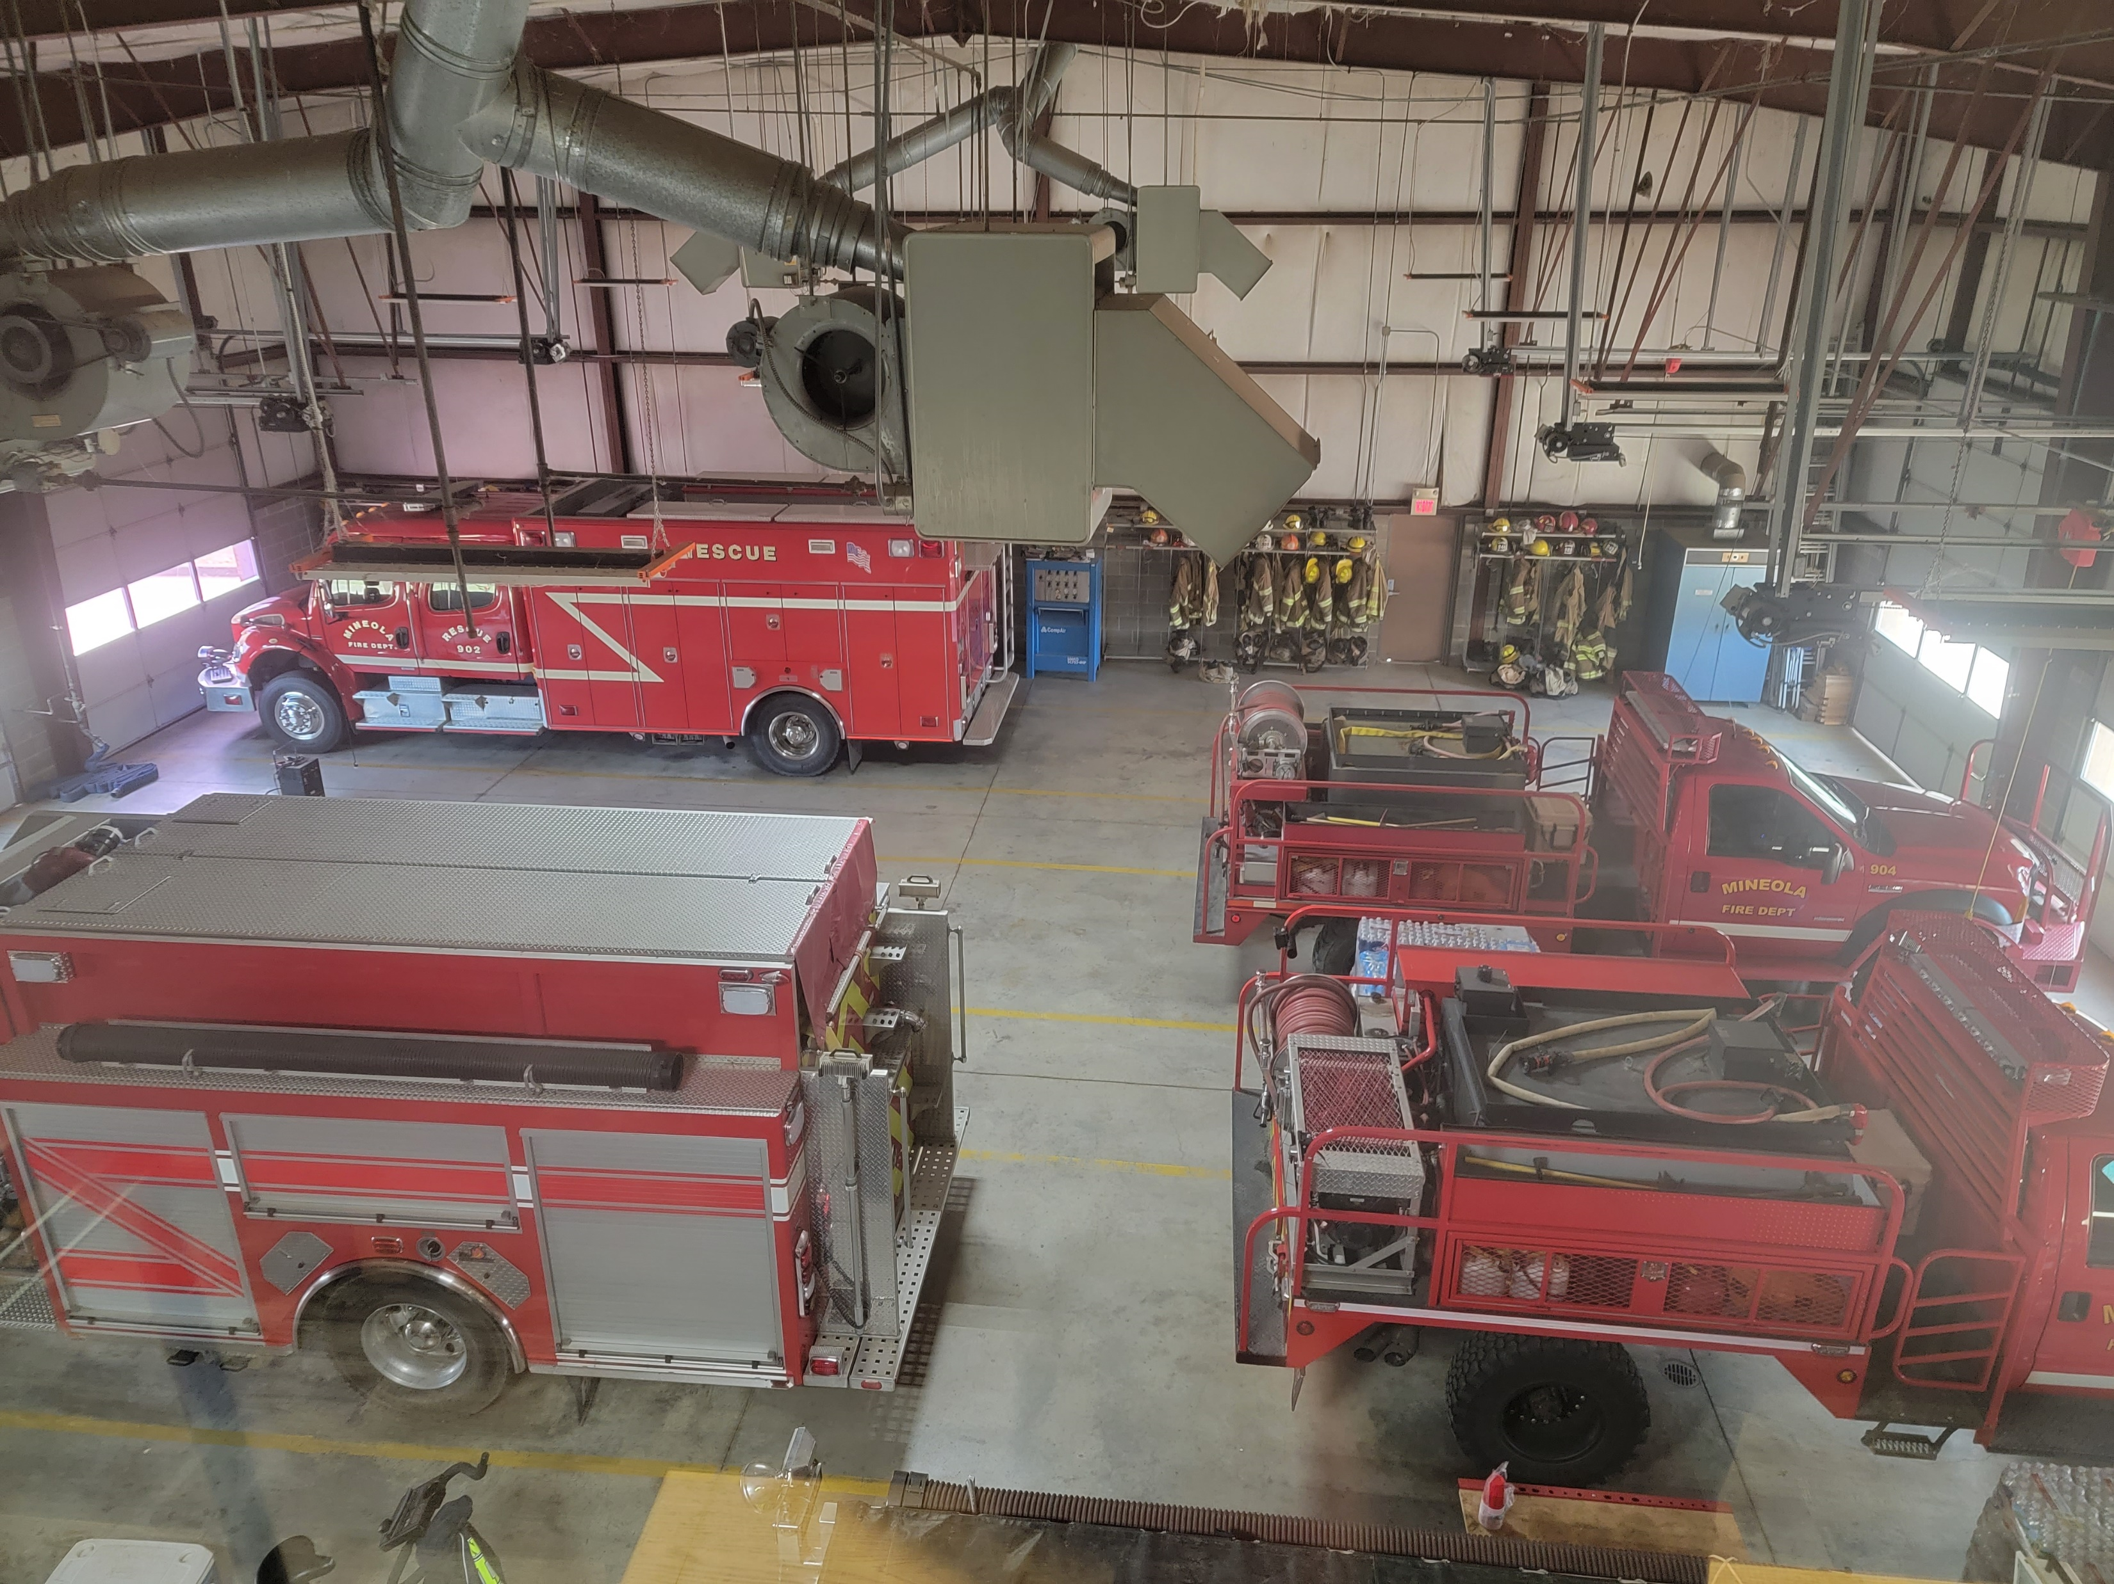
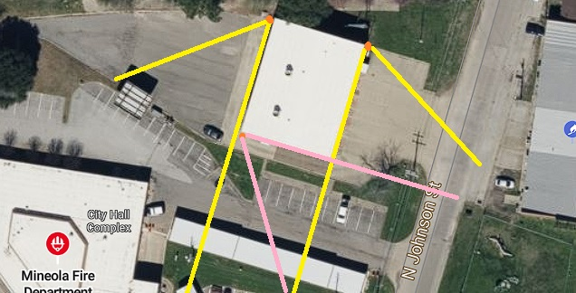
Budget Proposal
Alarm & Security Systems
5 Camera System (3 outdoor, 2 indoor)
2 Walk-thru doors Key Fob/ Punch Code Access
Local Monitoring at station and monitored by Mineola PD Dispatch
Cost
Cameras - $10,000
Door Access - $6,000
Total cost - $16,000

Slide 12
Budget Proposal
Small Ticket Items
Price Increases
Technology
Frontline Apparatus – iPads
Replacement Station Computer
Price Increases
Pyrotechnics – July 4th
Firefighting Foam
Personnel Physicals

